Slide 1
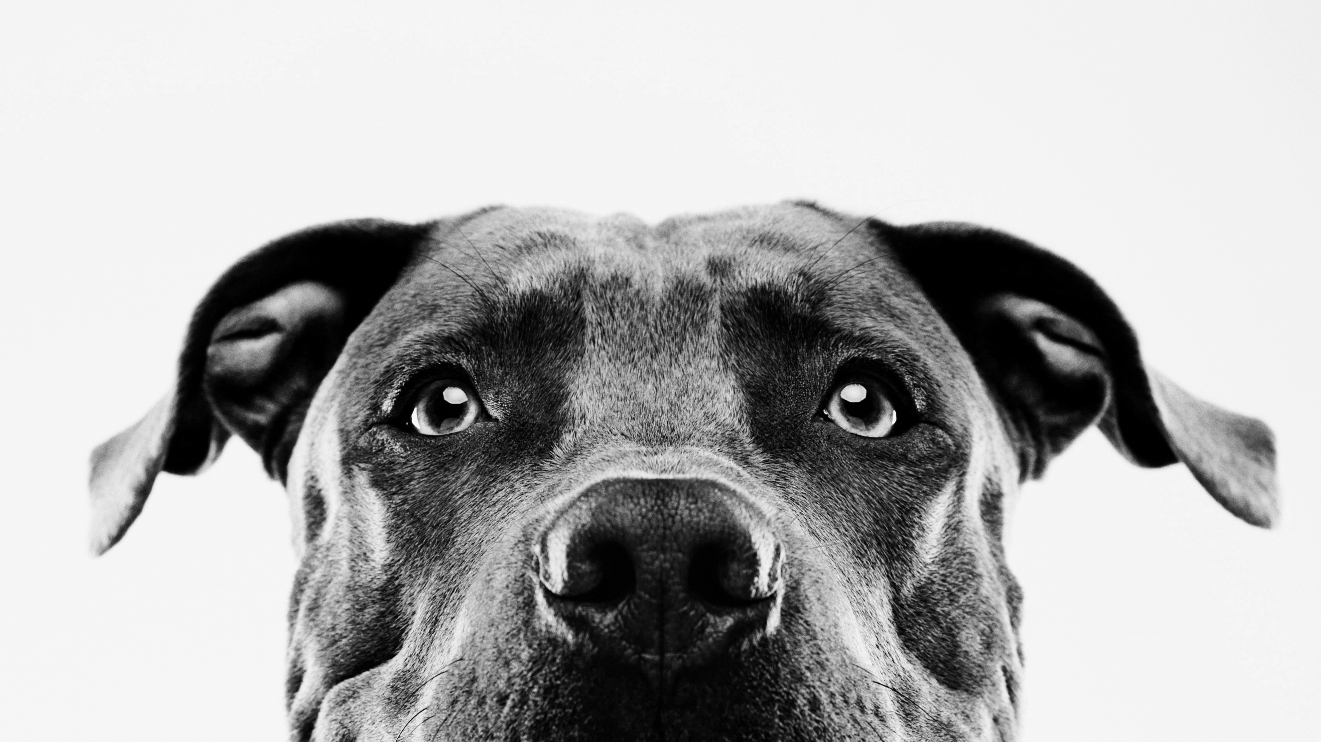
PawPics
A snap worth saving

Slide 2
Introduction
Cancer and breed information is just now becoming widely available
Breed-specific traits could assist in preventative care and treatment plan creation
Professional treatments come at high cost

Slide 3
Deploy a web-app instance of a deep learning model that predicts the breed mix of dogs in submitted images
Primary
Goals

Slide 4
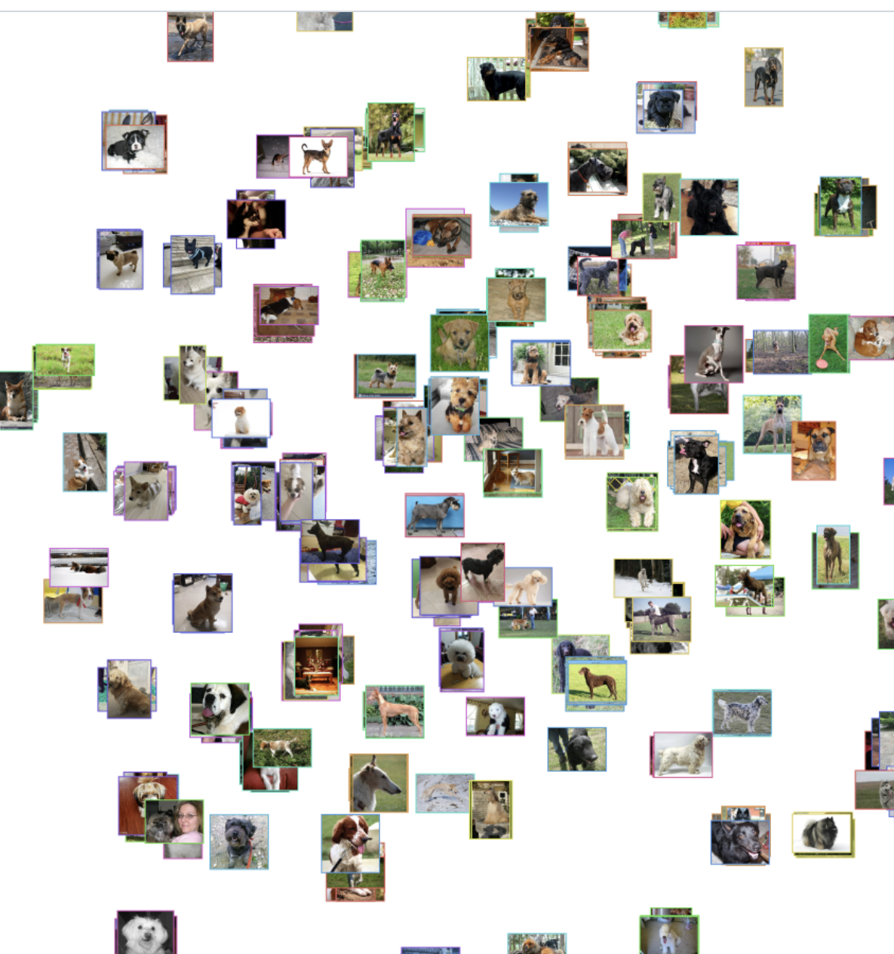
Data & Methodology
Stanford Dogs Dataset
20,580 images across 120 breeds
Sourced from imagenet
Tsinghua Dogs Dataset
70,428 images across 126 breeds
Sourced from pet owner photos in Tsinghua area

Slide 5
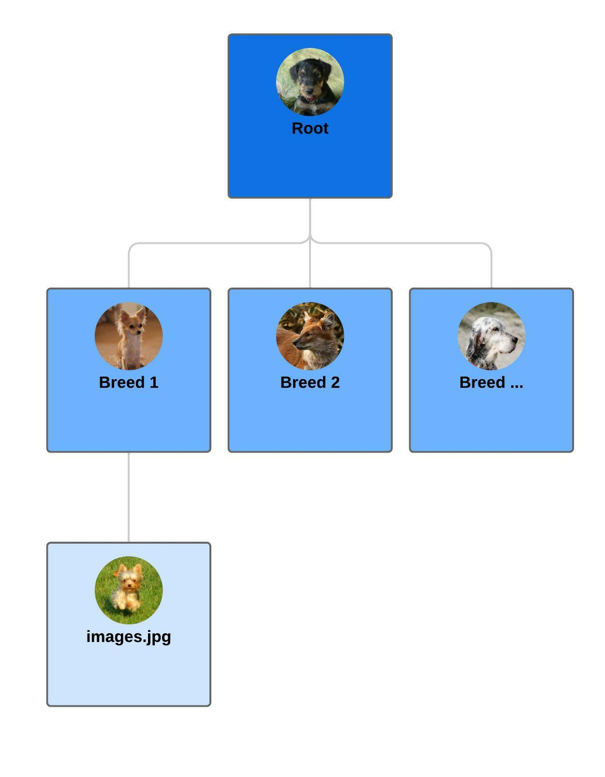
Pipeline Development
Automated reading of folders to extract breed names and intermix datasets
Novel Train/Test split created at .75/.25 – all inclusive
Automated Directory distribution to facilitate data generators
Automatic preprocessing for model in generators
Automated Model training and Pickling

Slide 6

Results & Reflections

Slide 7
Takeaways & Next Steps
Local machine incompatibilities highlight the benefits of cloud computing
Additional work on user interface necessary
Exceedingly accurate results seen from Resnet50
Encompass all steps in single executable .py file

